Slide 1
Case study review
SMARTBILL
TEAM - 12

Slide 2
objective
Enhanced electric bill services by improving efficiency and accuracy.
Streamline account registration, management, and billing to make it simple for customers.
Enabled easy login so customers can quickly access their accounts.
Allowed personal detail updates, bill viewing, and payments to be done effortlessly.
Simplified bill payments with an intuitive interface. Provided easy access to billing history and complaints.
Included search and tracking features for customer complaints to ensure they are addressed promptly
Equip admins with tools to manage accounts, update complaints, and add bills efficiently.
Ensured smooth interaction between system components for a seamless experience.
Incorporated strong error handling and optimize database performance for reliability.

Slide 3
PRODUCT BACKLOG
SNO | Features( Including UI, Servlets, DAO, Model | Involved Person | Status
1 | Admin: Add Bills, Complaint Status Update, View Bills Status of all consumers, View all consumers Consumer: Pay Bills | 2747590 – Sai Sri Harsha Rankela | Completed
2 | Consumer: Consumer Registration, Payment History, Search Payment Details by transaction number | 2747558 – Neelima Tayya | Completed
3 | Consumer: View Bills, Search Bill by Bill Id | 2731688 – S R A R Pramod Grandhi | Completed
4 | Consumer: Register Complaint, View Complaints, Search Complaint by Complaint ID | 2732582 – Bhuvaneswar Jhade | Completed
5 | Consumer: Login Admin: Login | 2731556 – Balaji Amjuri | Completed
6 | Consumer: Edit Profile | 2747753 – Vasani Sai Chaithrika | Completed
7 | Consumer: Soft Delete and Recover Account | 2727876 – Simhadri Mohith | Completed
8 | Code Integration and Testing | ALL | Completed

Slide 4
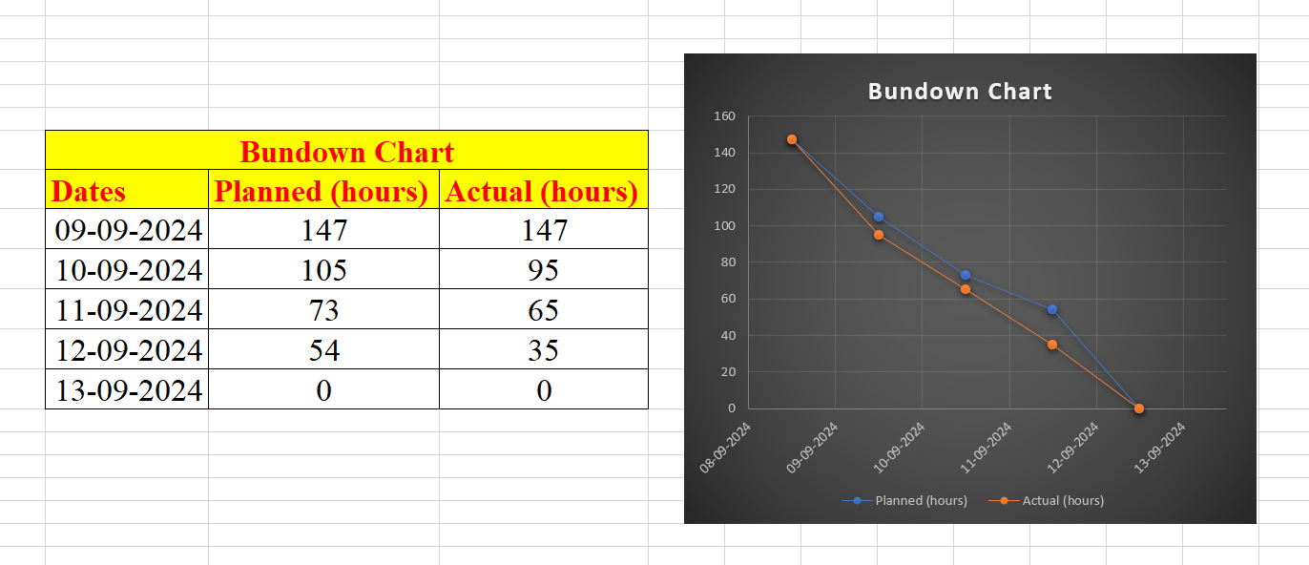
SPRINT BUNDOWN CHART

Slide 5
THANK YOU

